Slide 1
Animal Detection and Identification using Machine Learning
Shri Shankaracharya Institute of Professional Management & Technology, Raipur
Major Project(Phase-I) Report on
CSE 7th Semester
Department of Computer Science and Engineering,
Batch 2019-2023
Session July – Dec 2022
Presentation Date: 24-01-23
Project Group Members:
Shubhanshu Tiwari
Siddharth V. Pillai
Vipin Chandra Sao
Project Guide
Mr. Yogesh Kumar Rathore
(Assistant Professor, CSE)

Slide 2
Introduction about Project
Observing wild animals in their natural environments is a central task in ecology. The fast growth of human population and the endless pursuit of economic development are making over-exploitation of natural resources, causing rapid, novel and substantial changes to Earth’s ecosystems. An increasing area of land surface has been transformed by human action, altering wildlife population, habitat and behaviour. More seriously many wild species on Earth have been driven to extinction, and many species are introduced into new areas where they can disrupt both natural and human systems. Monitoring wild animals, therefore, is essential as it provides researchers evidences to inform conservation and management decisions to maintain diverse, balanced and sustainable ecosystems in the face of those changes.
Various modern technologies have been developed for wild animal monitoring, including radio tracking, wireless sensor network tracking, satellite and global positioning system (GPS) tracking, and monitoring by motion sensitive camera traps. Motion-triggered remote cameras or “camera traps” are an increasingly popular tool for wildlife monitoring, due to their novel features equipped, wider commercial availability, and the ease of deployment and operation

Slide 3
Application Area
Application & Benefits:-
We can study the habitat of various animals and their surrounding which can be used to gain knowledge about different animal and their species.
End users of project:-
This project can be used by Wildlife Centuries to understand the ecosystem of animals present in the century.
It can also be used in zoo to monitor animals.
People can use this in everyday life to identify animal and gain knowledge.

Slide 4
Literature Review
[1] The paper talks about the conflict between humans and animals like monkey menace in urban areas and provides an effective solution by deploying intrusion detection applied with the help of wireless sensor based network based on UWB technology. The paper informs about SVM or softmax classifier to classify humans from animals. The intrusion of animals will be found by analysing the UWB signals of the objects that entered the network , and extracting the features using convolutional neural network. The method proposed by the paper can allow us to detect human and animal invasion effectively with improved accuracy of 16% with respect to traditional manual extraction.
[2] The paper tries to tackle the problem of collision of animals and vehicles on roads which result in ecological imbalance. This paper tries to use animal detection via cameras that are installed on the roadside. The methodology used allows us to classify areas of image into two parts: animal and non-animal. In this paper, KNN and RF were used to process the features and it was found that KNN learning model was more reliable than Random Forest. For future, the paper suggested the use of deep learning to check for best possible methods in several conditions.
[3] The paper stated about the problem regarding the causalities and wounds caused due to road accidents due to collision with animals on mainly highways. The paper tries to implement a low cost animal detection using computer vision. The algorithm used for detection is based on HOG and cascade classifier. Training is done on more than 2000 images which contains positive and negative images. The system was ale to achieve max accuracy of 82.5% for detection. The limitation regarding the system is that it can detect and prevent collision till the range of 30-35km/h after which the system can detect but cant prevent the collision.

Slide 5
Methodology
We downloaded the Animal Image dataset from Kaggle (https://www.kaggle.com/datasets/iamsouravbanerjee/animal-image-dataset-90-different-animals) which consists of 90 different classes. In this Dataset, we have 5400 Animal Images in 90 different categories or classes. Then we label the image using labelImg software. After labelling the data is feed to RESNet50 model for training afterwards testing is done. For YOLOv5 we take 3 classes out of the 90 classes available namely lion, tiger and elephant for training the model. After training YOLOv5 we test the model. Furthermore this model can be leveraged to create a wildlife monitoring system.

Slide 6
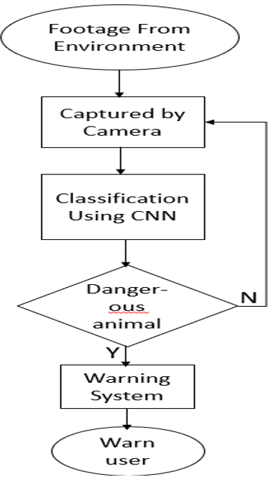
Project Work Flow Diagram

Slide 7
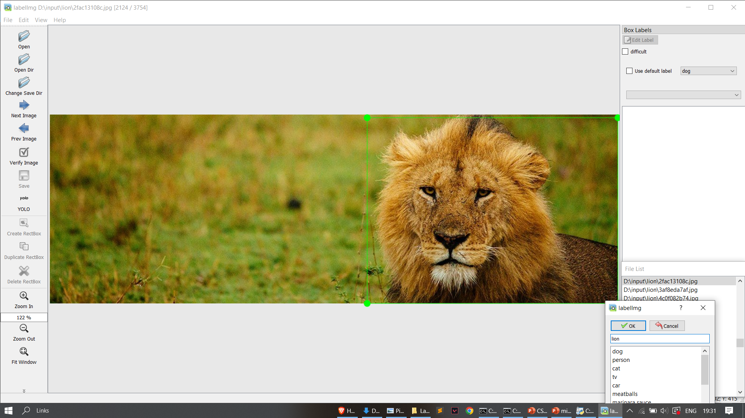
Result & Conclusion
Using labelImg for labelling the dataset

Slide 8
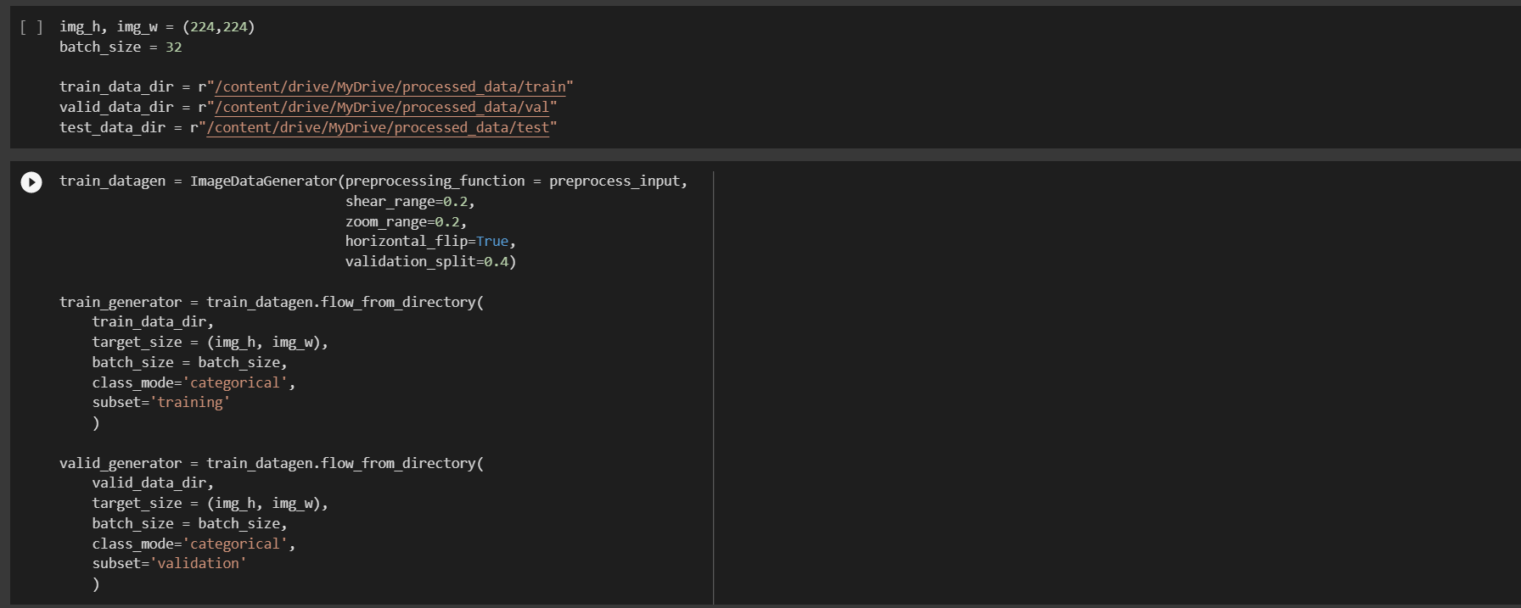
Result & Conclusion
Shows your Project outcomes
Snapshot with description
Dividing dataset into testing, training and validation dataset.

Slide 9
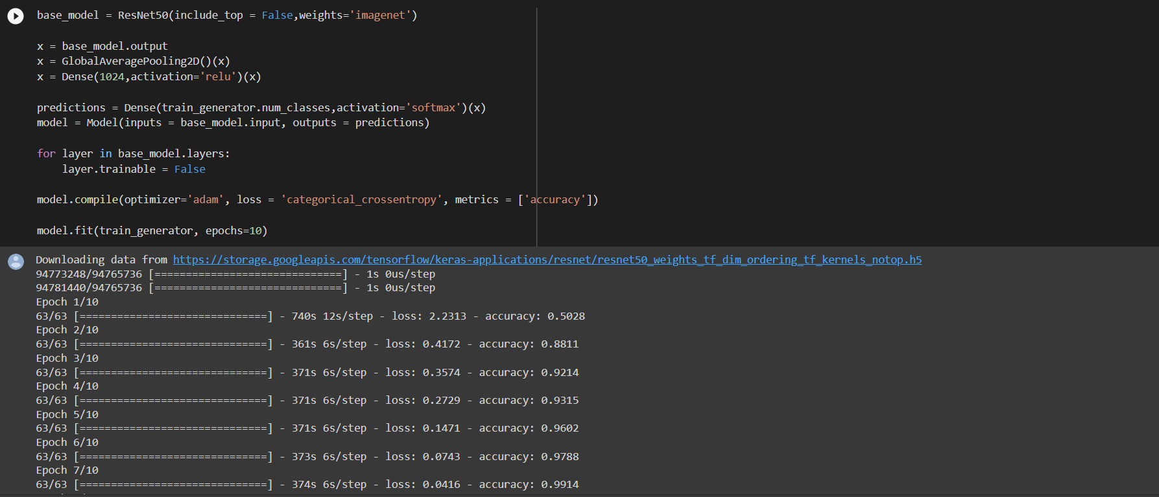
Result & Conclusion
Training the ResNet50 model with 10 epochs.

Slide 10
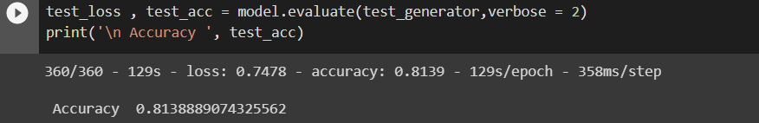
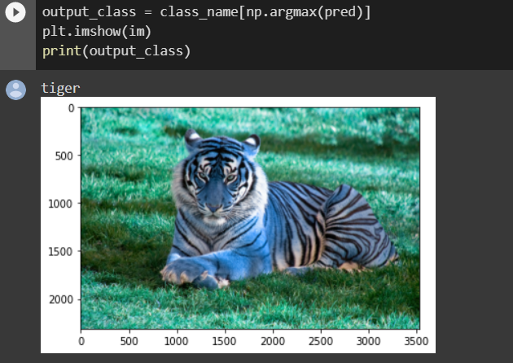
Result & Conclusion
Checking accuracy of RESnet model.
Testing the RESnet model with user input.

Slide 11
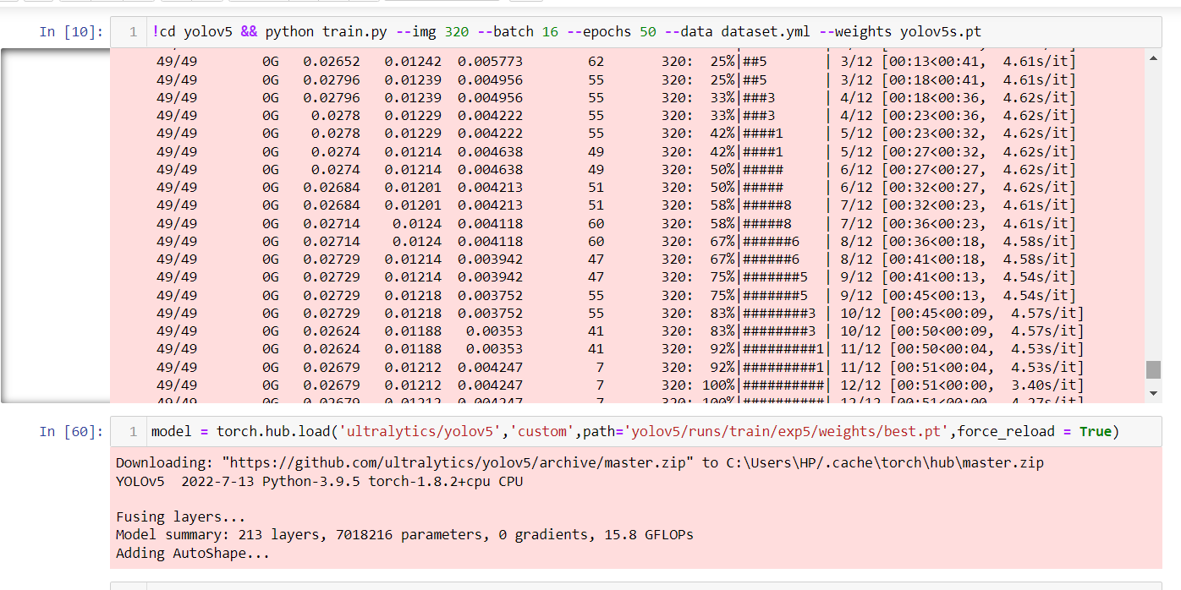
Result & Conclusion
Training YOLOv5 model on 3 classes

Slide 12
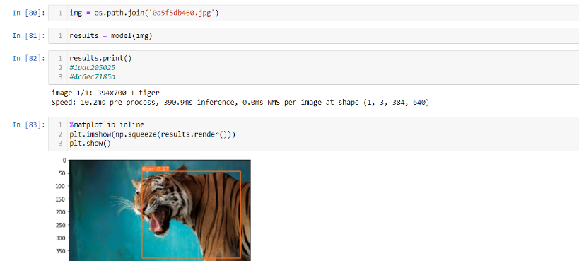
Result & Conclusion
Testing YOLOv5 on input image

Slide 13
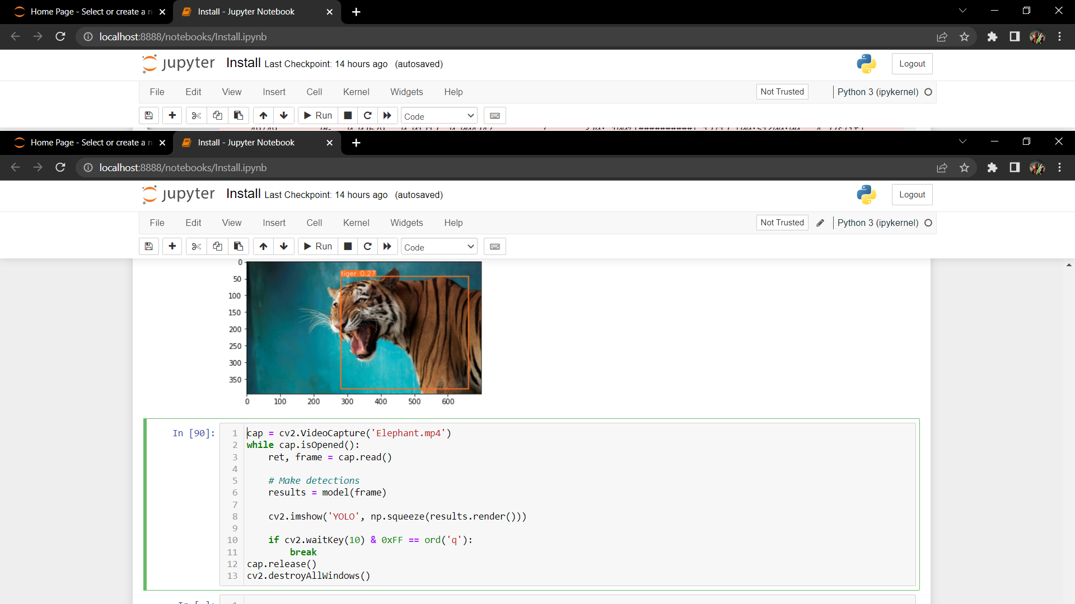
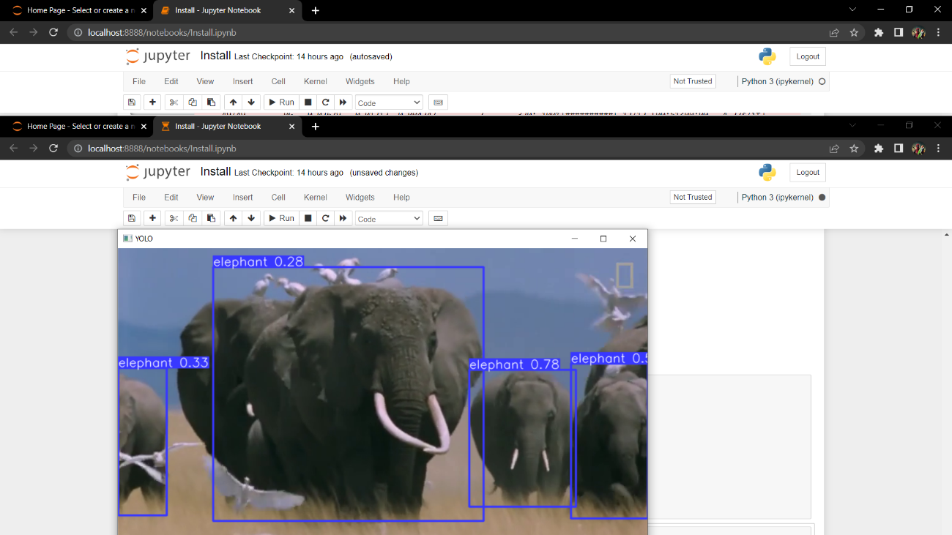
Result & Conclusion
Testing YOLOv5 on video

Slide 14
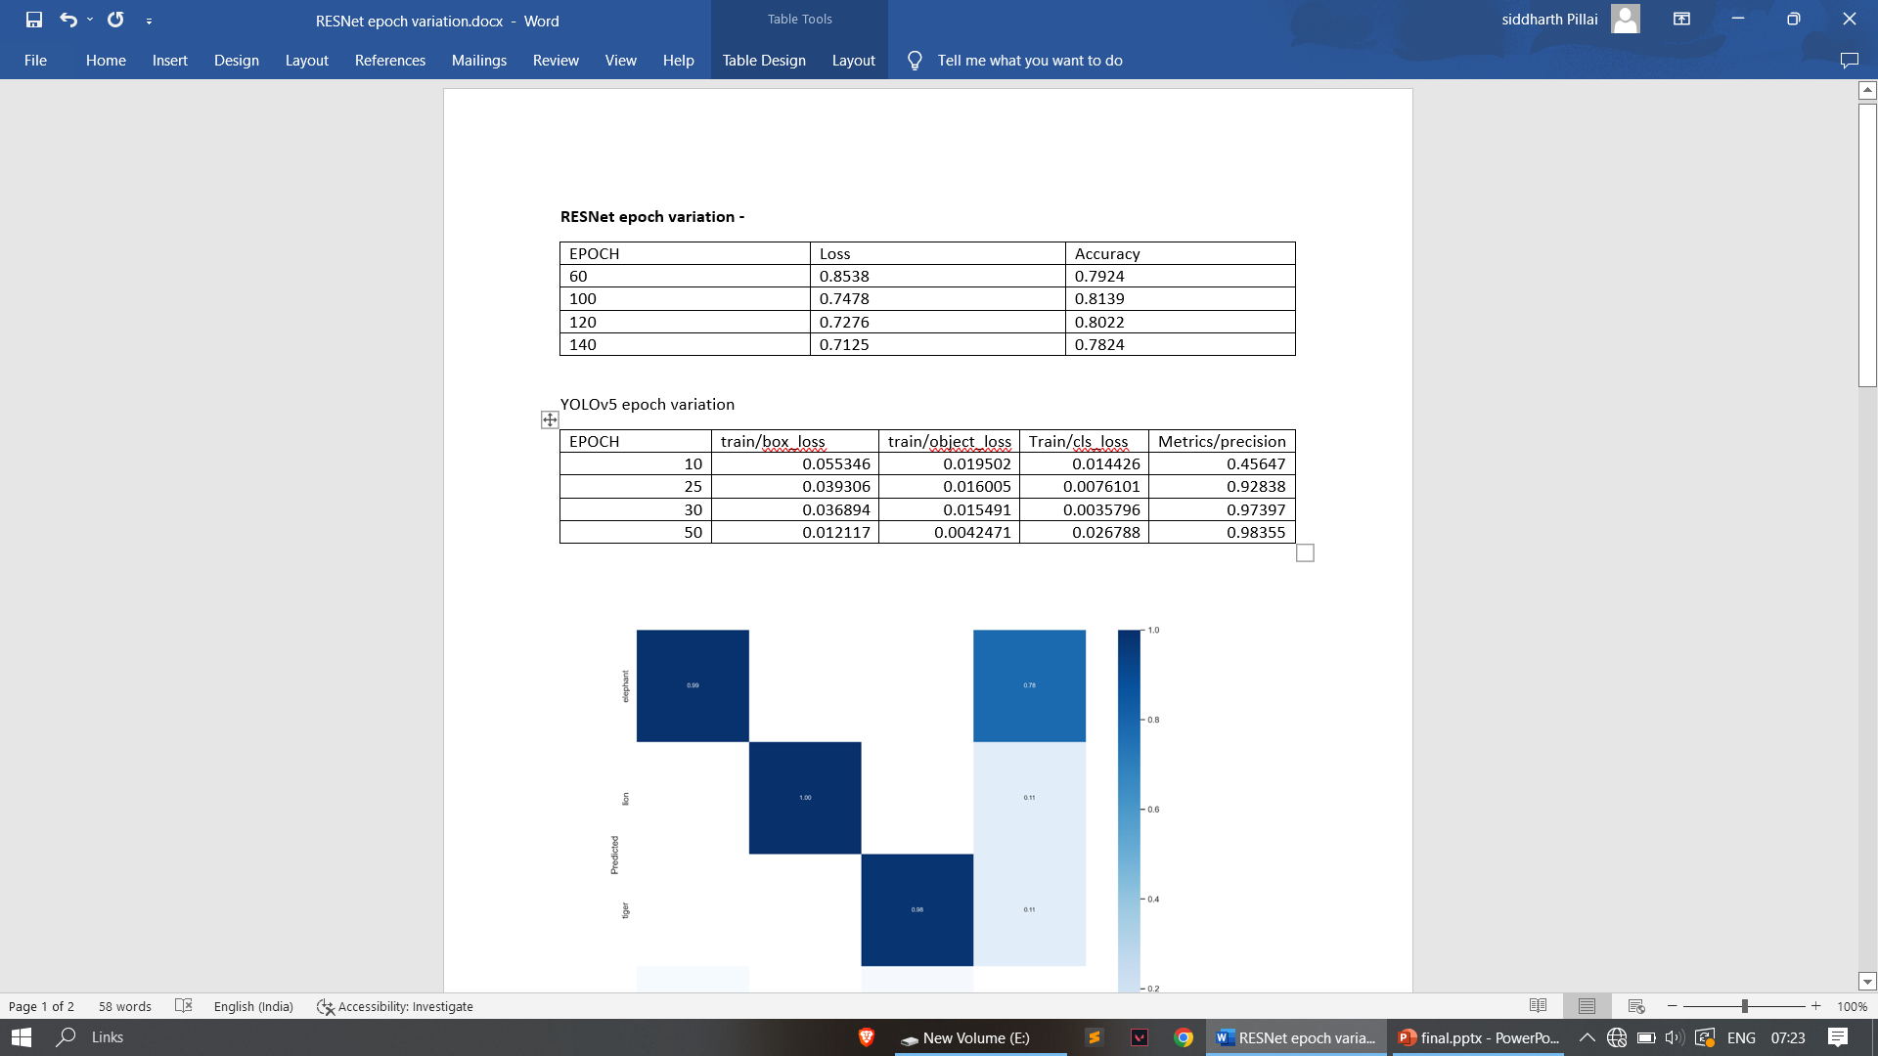
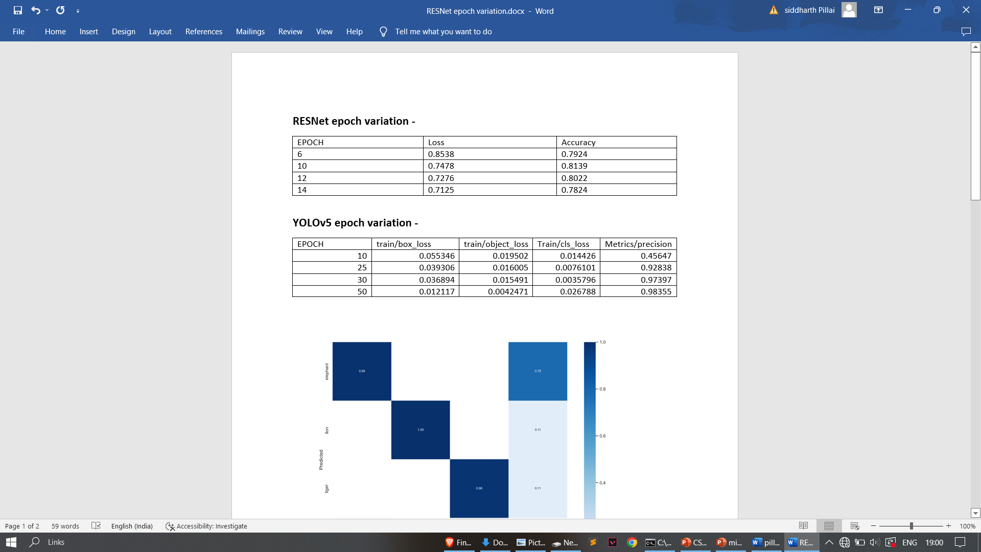
Result & Conclusion
The above two table tells about the performance of both RESNet50 and YOLOv5 model performance
on the basis of epoch variation and it is seen that for RESnet50 after 100 epoch the loss starts decreasing
But accuracy also decreases. For YOLOv5 50 epoch gives the max performance and highest accuracy.

Slide 15
References
Books and Research Papers -
[1] Animal Intrusion Detection Based on Convolutional Neural Network byWenlingXue*, Ting Jiang*, Key Laboratory of Universal Wireless Communication Beijing University of Posts and Telecommunications Beijing, China,Ting Jiang* School of Electronic and Computer Engineering, ZhijiangWanliUniversity,Ningbo, China.
[2] A Proposal of an Animal Detection System Using Machine Learning by William H. S. Antônio, Matheus Da Silva, Rodrigo S. Miani& Jefferson R. Souza
[3] A Practical Animal Detection and Collision Avoidance System Using Computer Vision Technique by SACHIN UMESH SHARMA¹ AND DHARMESH J. SHAH². 1 - Department of Electronics and Communication, Gujarat Technological University, Ahmedabad 382424, India. 2 - Department of Electronics and Communication, Sankalchand Patel University, Visnagar 384315, India.
Websites –
https://www.tensorflow.org/
https://pytorch.org/

Slide 16
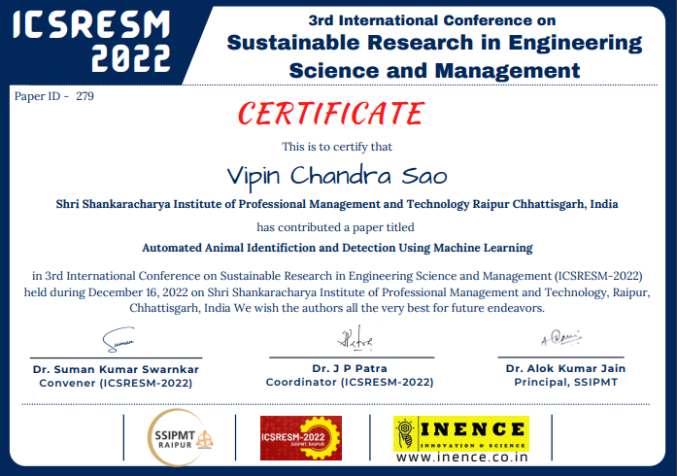
Paper Publication Details

Slide 17
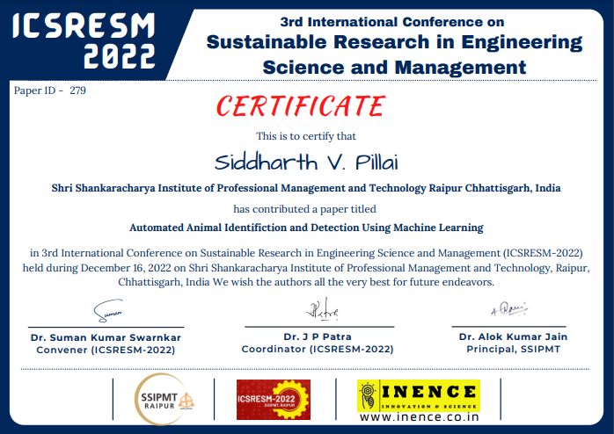
Paper Publication Details

